Slide 1
VEHICLE ROUTING PROBLEM
...an Advanced Algorithms Design project

Slide 2
ABSTRACT
The project aims at tackling the problem of inefficient vehicle sharing systems currently present in public transport domains and mobility on demand systems by suggesting changes in the way route planning and ride combining for sharing based systems is done while assuring optimization in several other domains.
In the Vehicle Routing Problem (VRP), the goal is to find optimal routes for multiple vehicles visiting a set of locations. A better way to define optimal routes is to minimize the length of the longest single route among all vehicles. This is the right definition if the goal is to complete all deliveries as soon as possible.

Slide 3
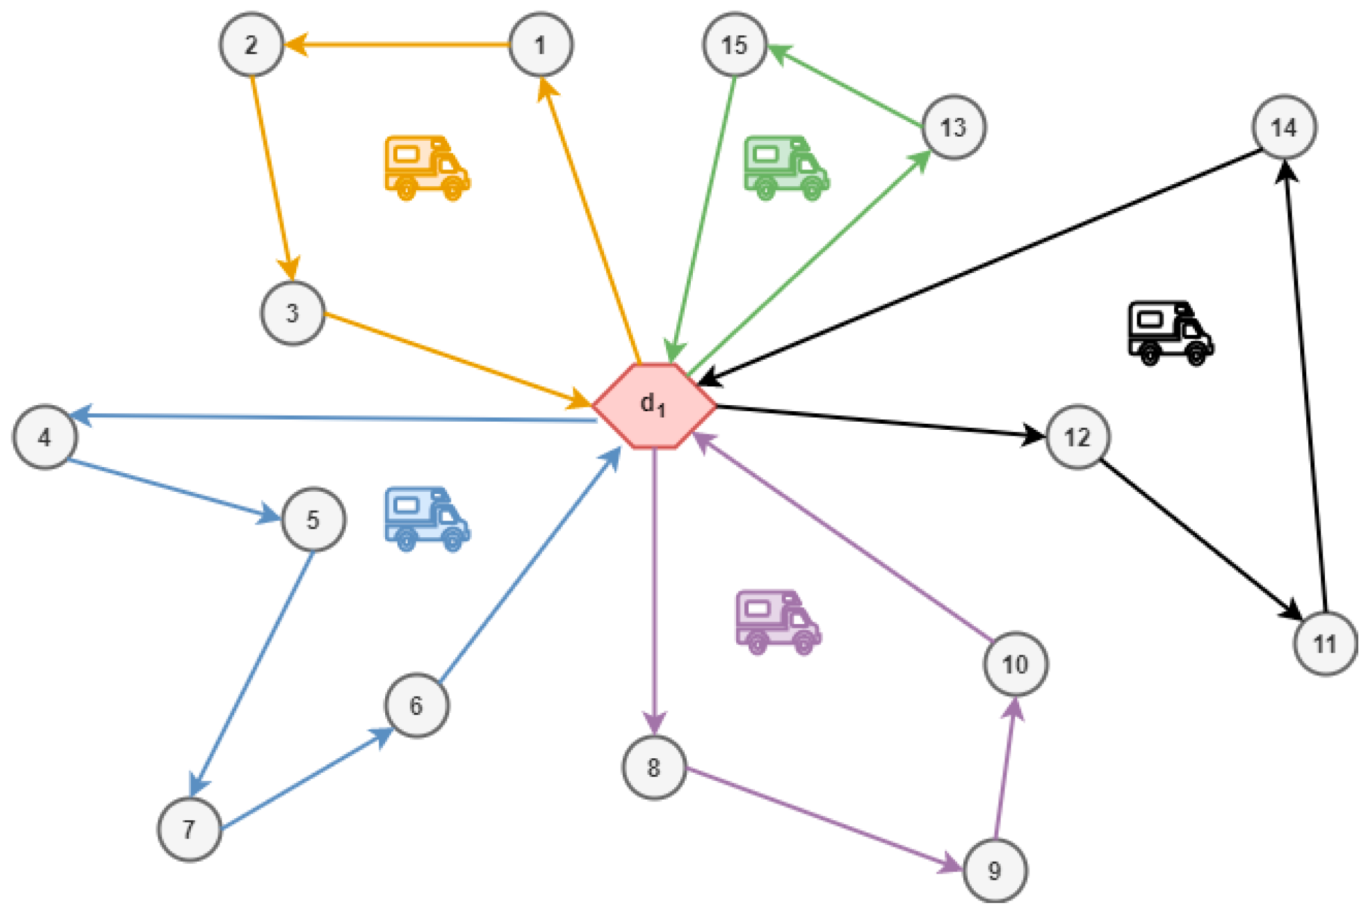
Vizualization of Vehicle Routing Problem

Slide 4
When there's only one vehicle, it reduces to the Traveling Salesman Problem

Slide 5
TRAVELLING SALESMAN PROBLEM
The travelling salesman problem is a graph theory optimization problem in which the nodes (cities) of a graph are bound by directed edges (routes), with the weight of an edge indicating the distance between two cities. The challenge is to find a route that reaches each city only once, returns to the starting point, and minimises the distance travelled.
This problem was first proposed in 1930 and has been one of the most intensively researched topics in optimization. Numerous optimization approaches use it as a benchmark. Even in its basic form, the TSP has many potential applications, which includes organizing, supply chain, and microchip manufacturing.

Slide 6
Vizualization of Travelling Salesman Problem

Slide 7
CAPACITY CONSTRAINTS
1

Slide 8
CAPACITY CONSTRAINTS
The capacitated vehicle routing problem (CVRP) is a vehicle routing problem in which vehicles with limited carrying capacity need to pick up items from various locations. The items have a quantity, such as weight or volume, and the vehicles have a maximum capacity that they can carry. The problem is to pick up or deliver the items for the least cost, while never exceeding the capacity of the vehicles.
The problem is to find an assignment of routes to vehicles that has the shortest total distance, and such that the total amount a vehicle is carrying never exceeds its capacity.

Slide 9
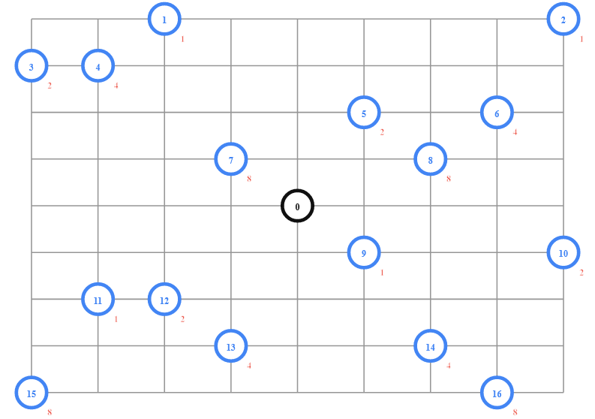
Example showing VRP with Capacity constraints

Slide 10
PICKUP - DELIVERY CONSTRAINTS
2

Slide 11
PICKUP - DELIVERY CONSTRAINTS
This is a VRP in which each vehicle picks up items at various locations and drops them off at others. The problem is to assign routes for the vehicles to pick up and deliver all the items, while minimizing the length of the longest route.
We ensure visiting each pickup and delivery stop exactly once, not exceeding the capacity of vehicles, and coupling the pickup and corresponding delivery stops on the same vehicle routes and impose visit precedence among each pickup stop and its associated drop-off stop. The problem has a variety of practical applications, including the transport of the disabled and elderly, sealift and airlift of cargo and troops, and pickup and delivery for overnight carriers or urban services.

Slide 12
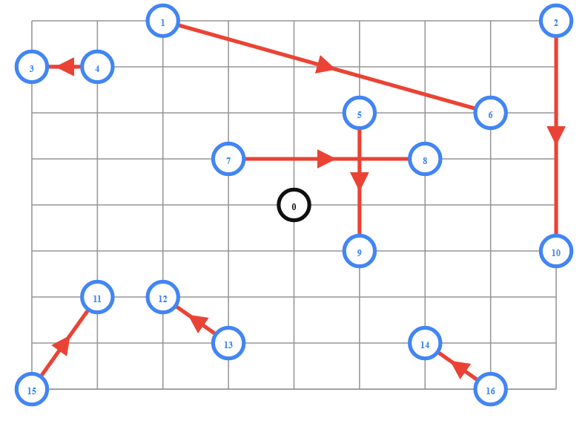
Example showing VRP with Pickup - Delivery Constraints

Slide 13
TIME WINDOW CONSTRAINTS
3

Slide 14
TIME WINDOW CONSTRAINTS
Vehicle routing problem with time windows (VRPTWs) is an important issue in logistics system which has been researched widely in recent years. The problem can be described as choosing routes for limited number of vehicles to serve a group of customers in the time windows.
Many vehicle routing problems involve scheduling visits to customers who are only available during specific time windows. Each vehicle has a limited capacity. It starts from the depot and terminates at the depot. Each customer should be served exactly once. The objective of the VRPTWs is to minimize the total transport costs.
The goal is to minimize the total travel time of the vehicles.

Slide 15
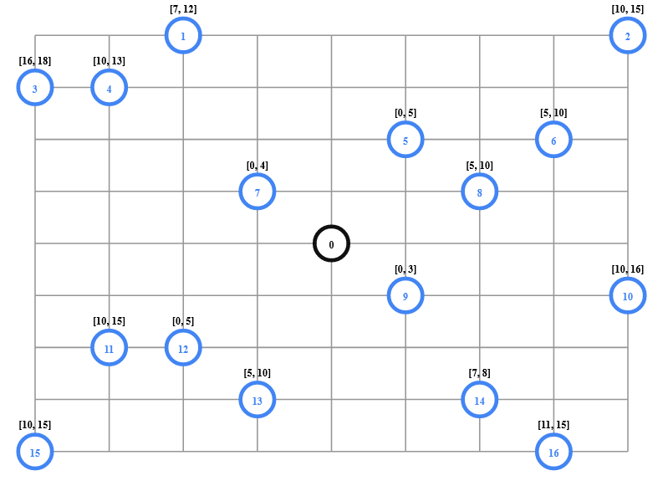
Example showing VRP with Time Window Constraints

Slide 16
RESOURCE CONSTRAINTS
4

Slide 17
RESOURCE CONSTRAINTS
This is the type of VRP with time windows that also has constraints at the depot: all vehicles need to be loaded before departing the depot and unloaded upon return. Since there are only two available loading docks, at most two vehicles can be loaded or unloaded at the same time. As a result, some vehicles must wait for others to be loaded, delaying their departure from the depot.
The problem is to find optimal vehicle routes for the VRPTW that also meet the loading and unloading constraints at the depot.

Slide 18
REAL WORLD IMPLEMENTATION
Using Google Directions API

Slide 19
REAL WORLD IMPLEMENTATION
The section shows how to use the Google Distance Matrix API to create the distance matrix for any set of locations defined by addresses, or by latitudes and longitudes. You can use the API to calculate the distance matrix for many types of routing problems.
If you have a Google Directions API key, you can solve TSPs of real-world locations with the Directions API, providing the locations in a URL and getting the response back as JSON. You'll need your own free Directions API key for development, or an enterprise key for commercial use.

Slide 20
REAL WORLD IMPLEMENTATION
A Distance Matrix API request is a long string containing the following:
API address: https://maps.googleapis.com/maps/api/distancematrix/json?. The end of the request, json, asks for the response in JSON.
Request options like units=imperial sets the language of the response to English.
Origin addresses: Travel starting points. For example, &origins=3610+Hacks+Cross+Rd+Memphis+TN. Spaces in the address are replaced with the + character. Multiple addresses are separated by a |.
Destination addresses: Travel ending points. For example, &destinations=3734+Elvis+Presley+Blvd+Memphis+TN
The API key: Credentials for the request, in the form &key=YOUR_API_KEY.
The response contains the travel distance (in miles and meters), and the travel duration (in minutes and seconds), between the two addresses.

Slide 21
THANKS!
Presented by:
Amit & Tushar

